Slide 1
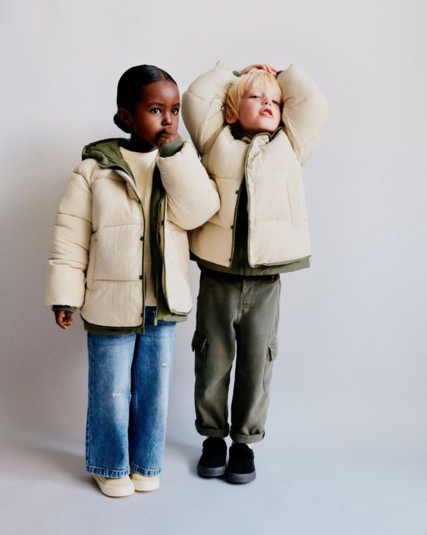

KID’S OUTERWEAR WEAR PRODUCT PRESENTATION

Slide 2
THANKYOU

